Slide 1

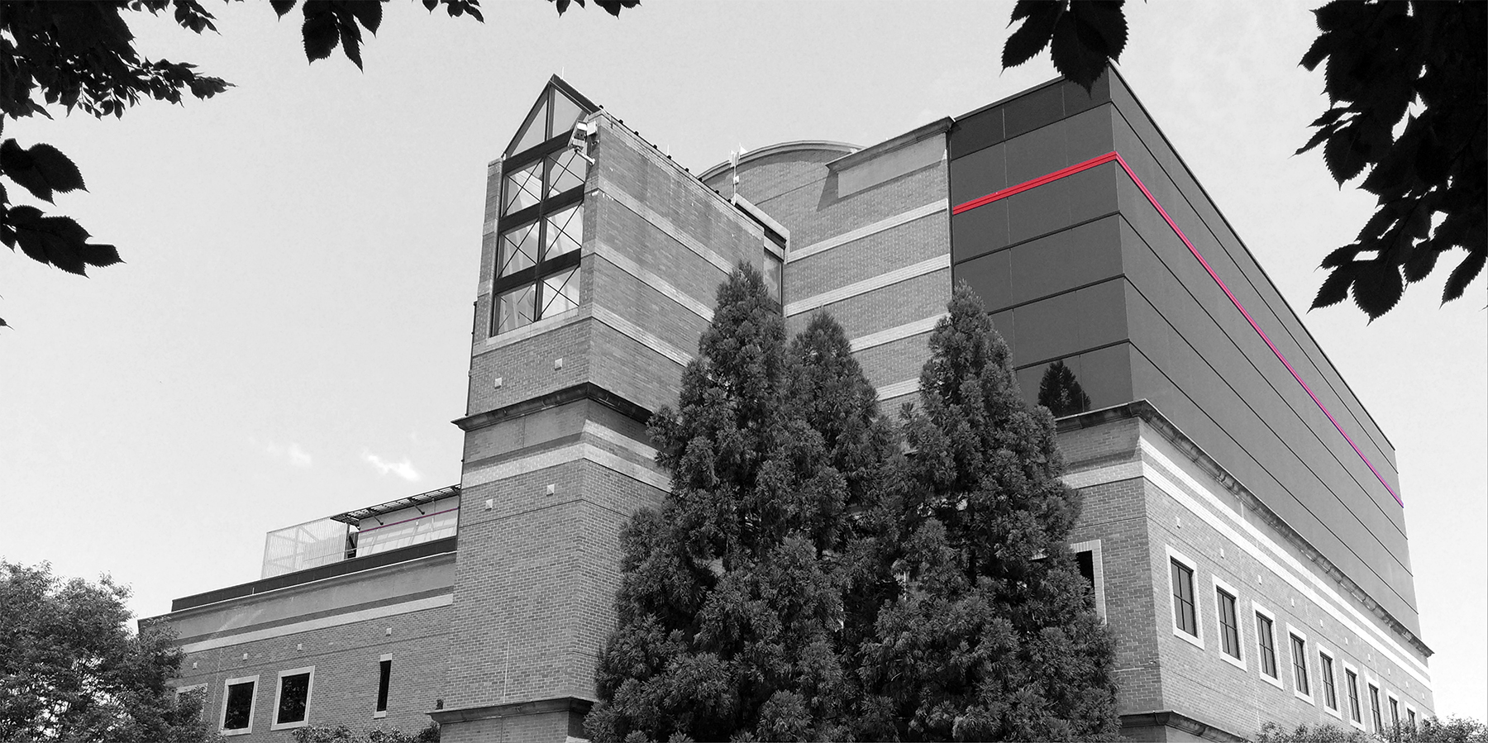
Disability Support Services Center
Baltimore City Community College

Slide 2

Online Registration Process
Before registering with Disability Support Services, students should first make sure that they are a registered student at BCCC.

Slide 3

7 Steps to Register with Disability Support Services Center

Slide 4
STEP 1
SELF DISCLOSURE
To register with DSSC students must disclose having a disability and needing accommodations.

Slide 5
STEP 2
DVF
Students must have a DVF/supportive documentation completed by a qualified practitioner. Forms can be emailed and/or downloaded from our website.

Slide 6
STEP 3
VERIFY DOCUMENTS
Students will email completed forms to DSSC. The DSSC Staff reviews all information to certify eligibility. The student will be contacted if additional information is required.

Slide 7
STEP 4
SCHEDULE INTAKE
The student is contacted by office staff to schedule an intake meeting.

Slide 8
STEP 5
ACCOMMODATIONS
During the Intake meeting, DSSC Staff will discuss Reasonable Accomodations that the student will receive to help them succeed.
Letter of Accommodations will be completed, electronically signed and sent to the student’s BCCC email address.

Slide 9
STEP 6
MEETING WITH FACULTY
The student is required to meet with their professors outside of scheduled class via zoom, canvas, telephone meeting, etc. to discuss the accommodations. At that time, the student and faculty will review the accommodation. Faculty electronically signs the acknowledgement form that confirms they have received a copy of the accommodation letter.

Slide 10
STEP 7
FACULTY SIGNATURES
The student will return completed faculty signature form to the DSSC OFFICE

Slide 11

This Photo by Unknown Author is licensed under CC BY-NC-ND

Slide 12
THANK YOU!
For more information:
Disability Support Services Center
dssc@bccc.edu
(410) 462-8589

